Slide 1

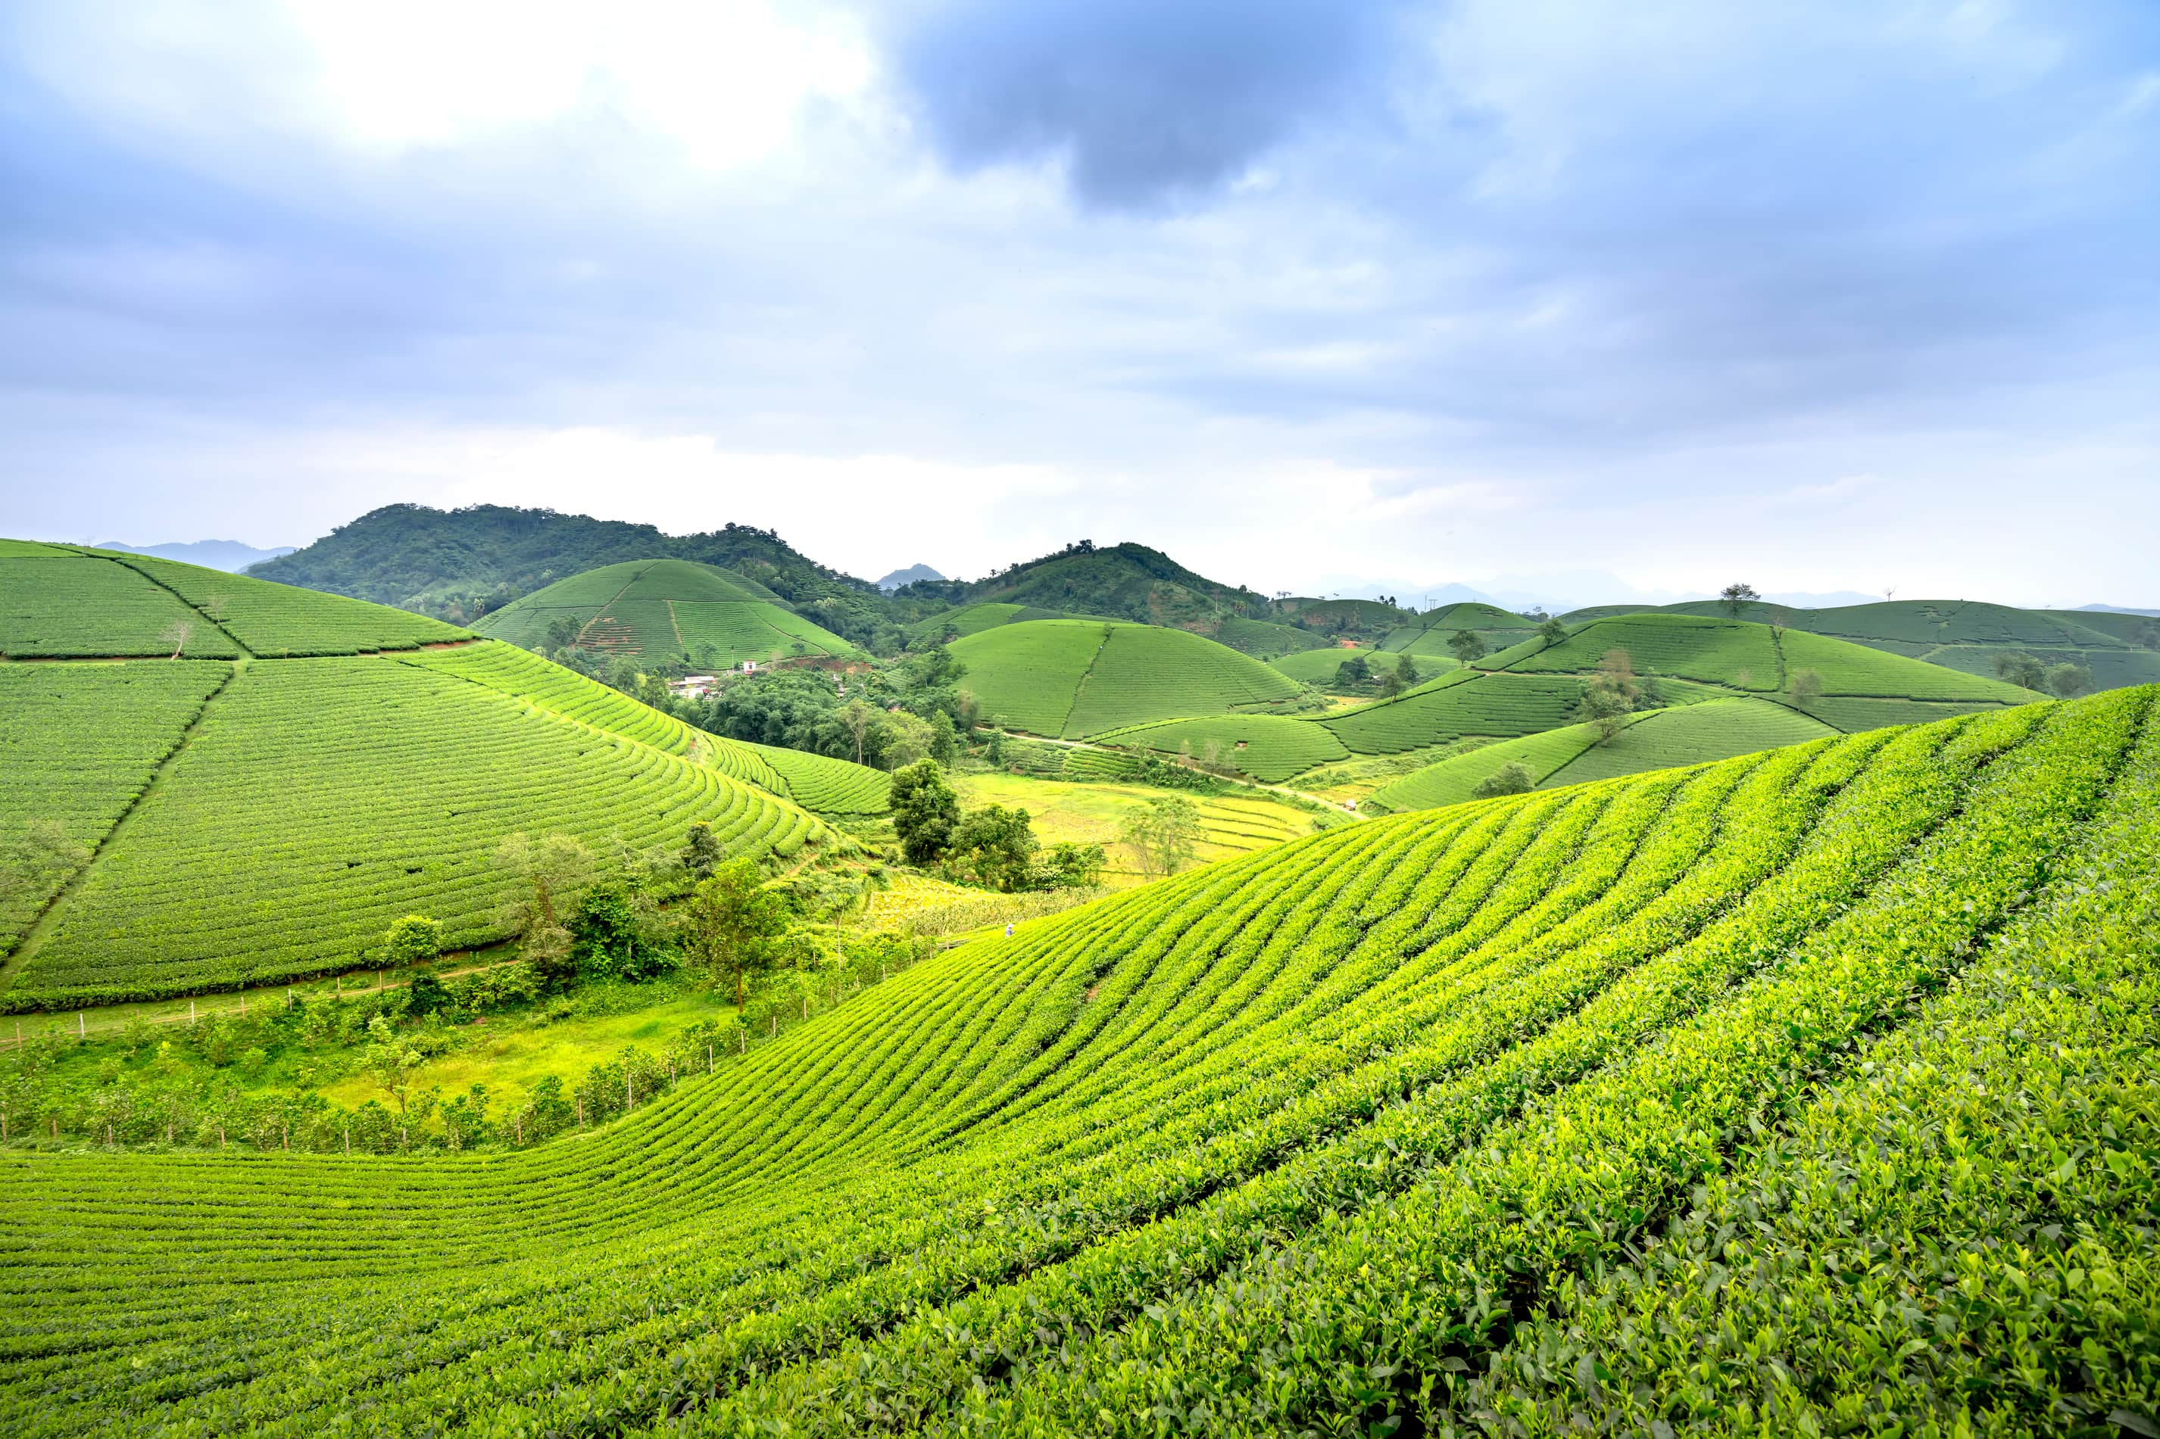
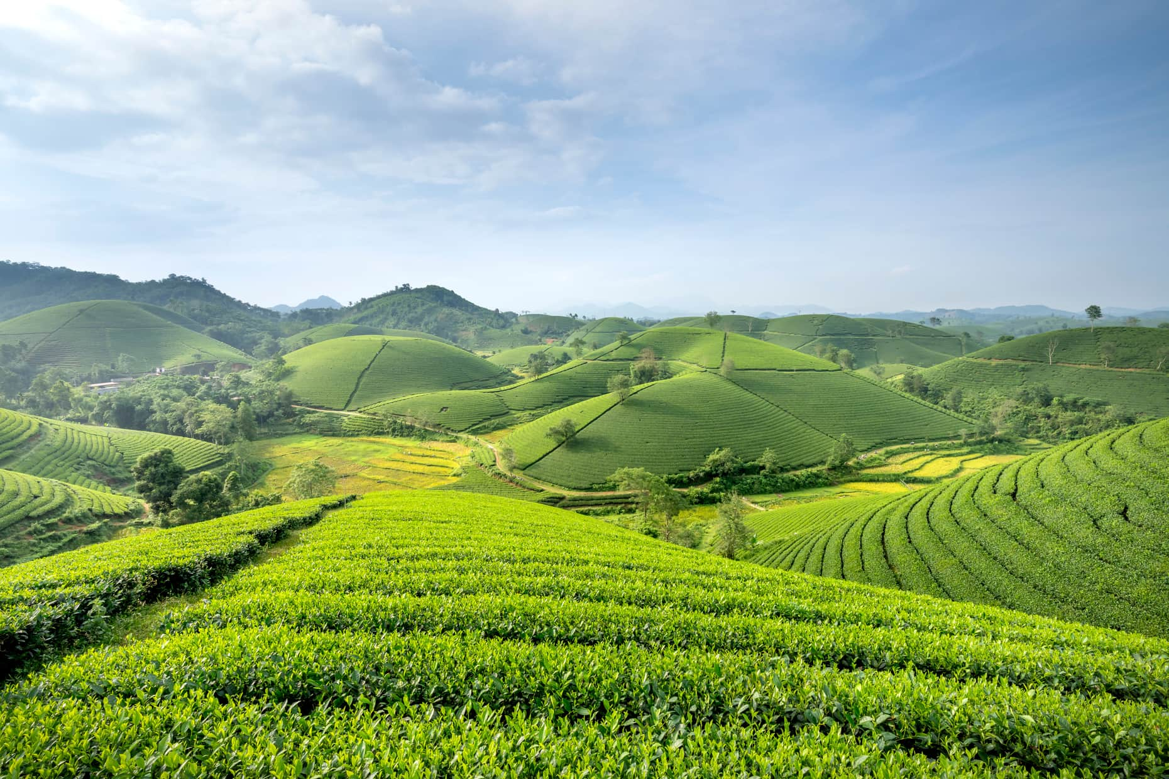
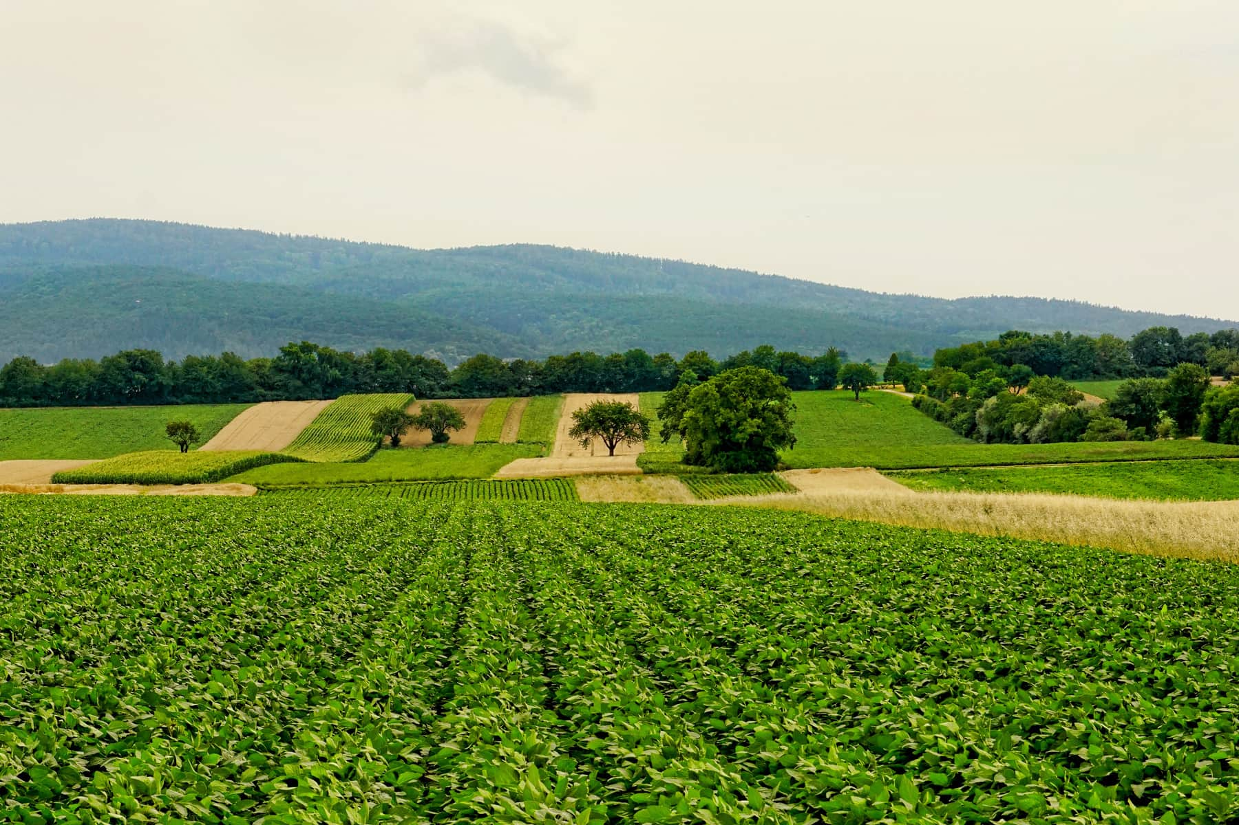
HarvestHorizon
=>A Smart Farmer Support System

Slide 2

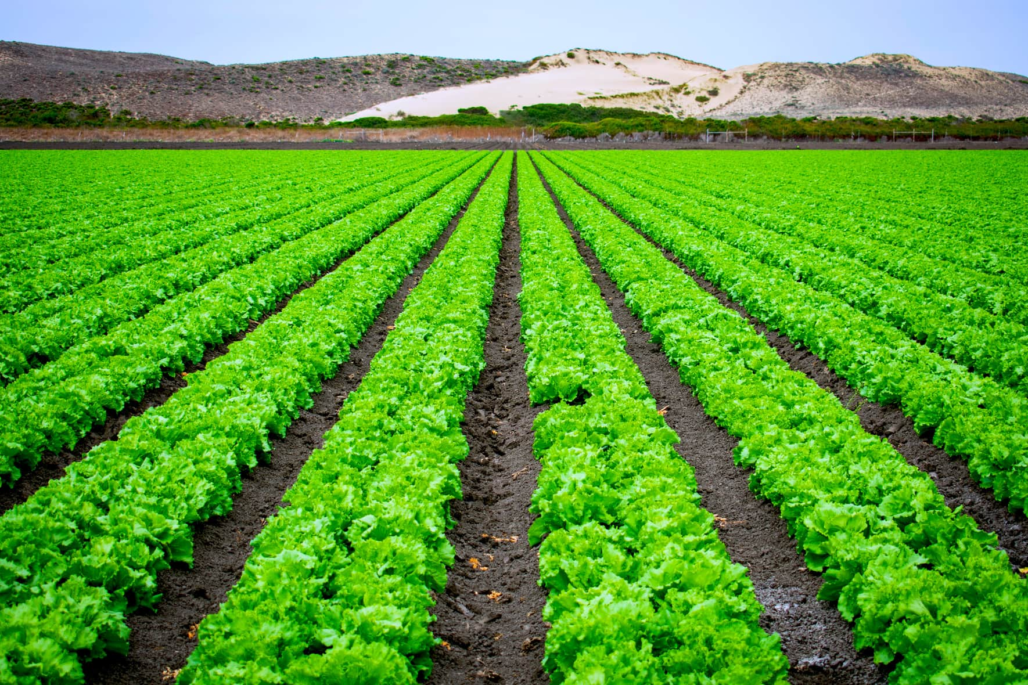
WorkFlow:
START
↓
Ask for Farmer Name and Land Size
↓
Ask for Crop details:
• Crop Name
• Crop Season
• Today’s Price
• Yesterday’s Price
↓
Validate inputs ⟶ Invalid? → Show error → END
↓
Check for Disease
• If yes → store disease name
• Else → mark “None”
↓
Check for Rainfall Damage
• If yes → enter affected land → calculate compensation (land × ₹5000)
• Else → mark “No rainfall damage”
↓
Generate Crop Report (Price trend, Disease suggestion, Compensation info)
↓
Ask if farmer wants to enter another crop
• Yes → repeat crop entry
• No → continue
↓
Generate Final Summary:
• Farmer details (name, land size)
• Profit/Loss count
• Total Compensation
↓
Print Market Price Table for all crops
↓
Display farewell message
↓
END

Slide 3
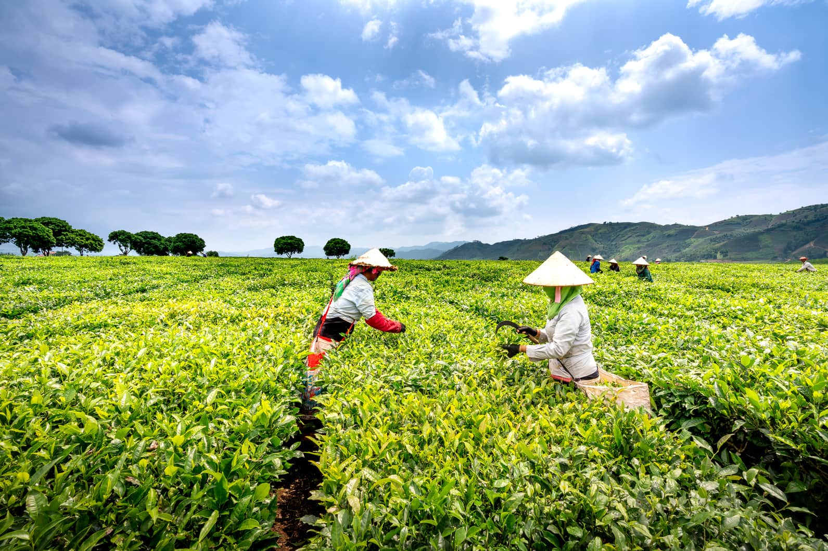
MainClass : HarvestHorizon
public class HarvestHorizonFinal {
public static void main(String[] args) {
Scanner sc = new Scanner(System.in);
List<Crop> crops = new ArrayList<>();
// Disease info database
Map<String, String> diseaseInfo = new HashMap<>();
diseaseInfo.put("Rice Blast", "Use Tricyclazole fungicide");
diseaseInfo.put("Wheat Rust", "Apply Mancozeb spray");
diseaseInfo.put("Cotton Wilt", "Use Carbendazim treatment");
diseaseInfo.put("Sugarcane Red Rot", "Use Bavistin fungicide");
System.out.print("Enter Farmer Name: ");
String farmerName = sc.nextLine();
System.out.print("Enter Land Size (in acres): ");
double landSize = sc.nextDouble();
sc.nextLine(); // consume newline
System.out.println("\n--- 🌾 Welcome to HarvestHorizon 🌾 ---");
// Crop entry and reporting loop
...
}
}
*Scanner: Used for standard console input from the farmer.
*ArrayList<Crop>: Stores all crop objects dynamically.
*HashMap<String, String>: Acts as a disease-suggestion database.
*Input Validation: Ensures crop details, prices, and disease info are entered correctly.
*Final Summary & Reports: Prints per-crop report and consolidated farmer summary.

Slide 4
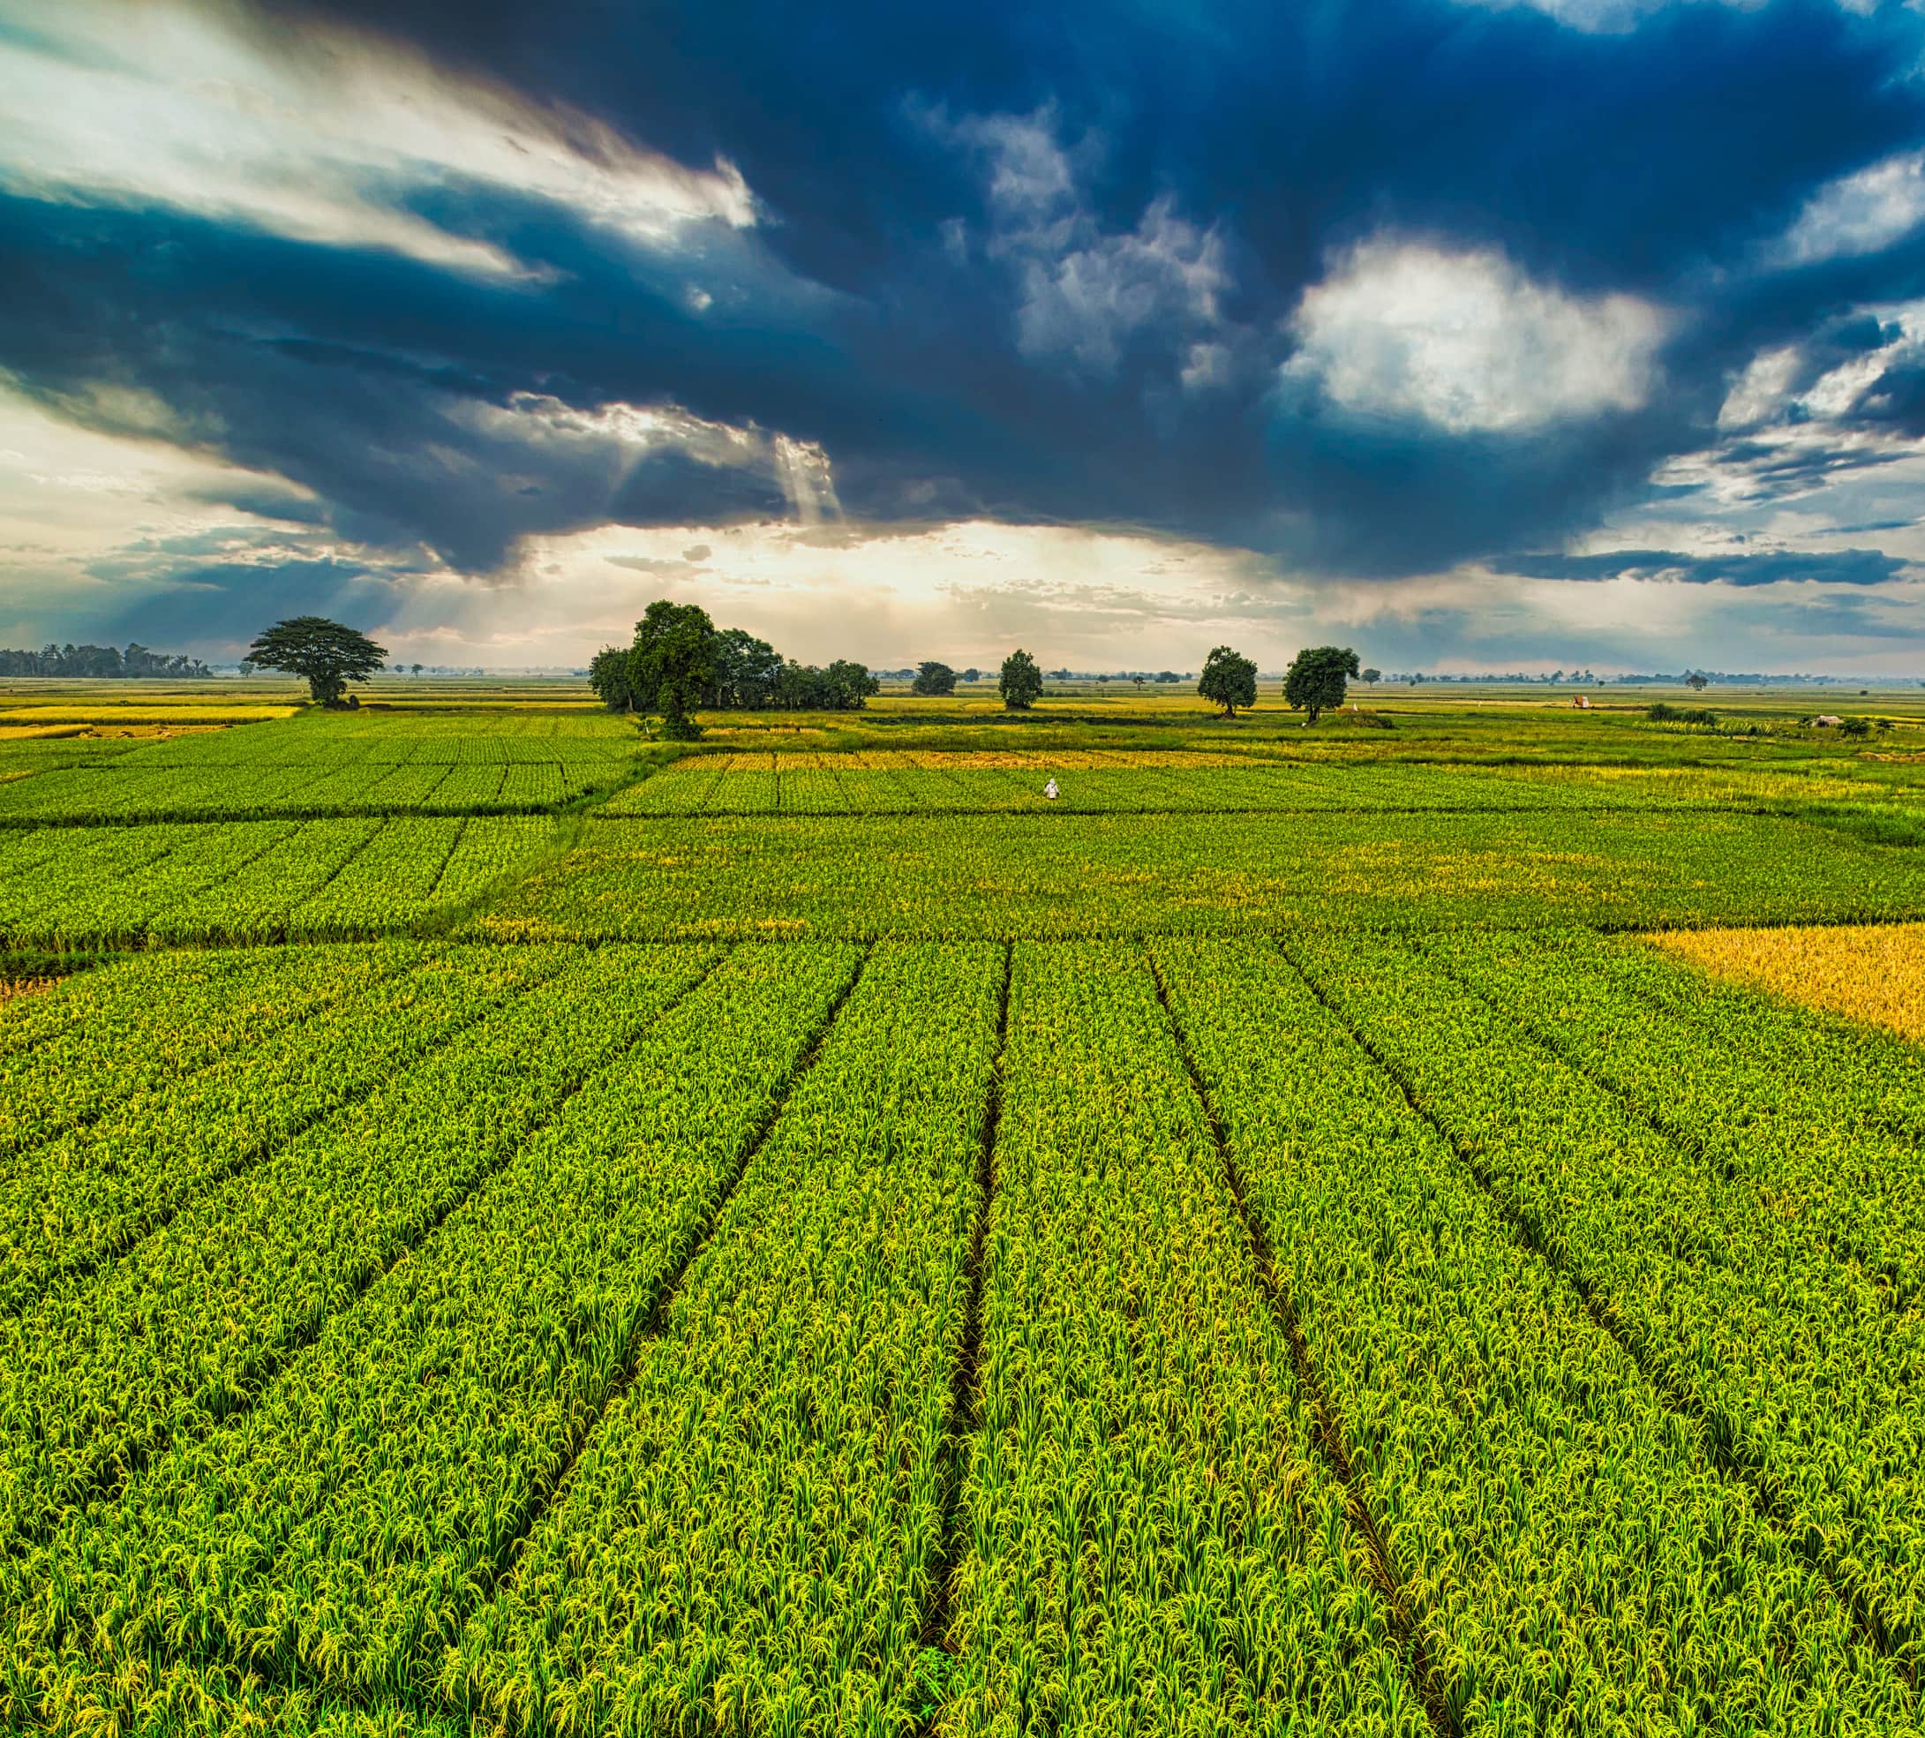
Printing the Suggestions 🌾
System.out.println("===== 🌾 HarvestHorizon Report =====");
System.out.println("👨‍🌾 Farmer Name: " + farmerName);
System.out.println("🌱 Crop: " + name + " (" + season + ")");
System.out.println("💰 Today’s Price: ₹" + todayPrice + "/kg | Yesterday: ₹" + yesterdayPrice + "/kg");
if (todayPrice > yesterdayPrice) {
System.out.println("📈 Price Change: +₹" + (todayPrice - yesterdayPrice) + " (Profit ↑)");
} else if (todayPrice < yesterdayPrice) {
System.out.println("📉 Price Change: -₹" + (yesterdayPrice - todayPrice) + " (Loss ↓)");
} else {
System.out.println("⚖ No price change compared to yesterday.");
}
if (!disease.equals("None")) {
System.out.println("🦠 Disease: " + disease + " → 💊 Suggestion: " + diseaseInfo.get(disease));
} else {
System.out.println("🦠 No disease reported");
}
if (rainAffectedLand > 0) {
System.out.println("🌧️ Rainfall Compensation: ₹" + compensation + " (Affected: " + rainAffectedLand + " acres)");
} else {
System.out.println("🌧️ No rainfall damage reported");
}

Slide 5
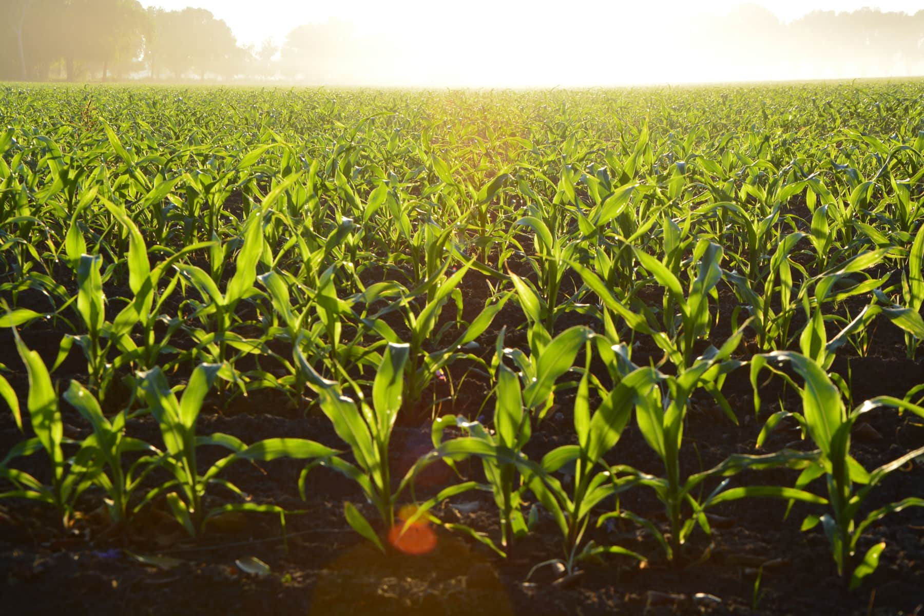
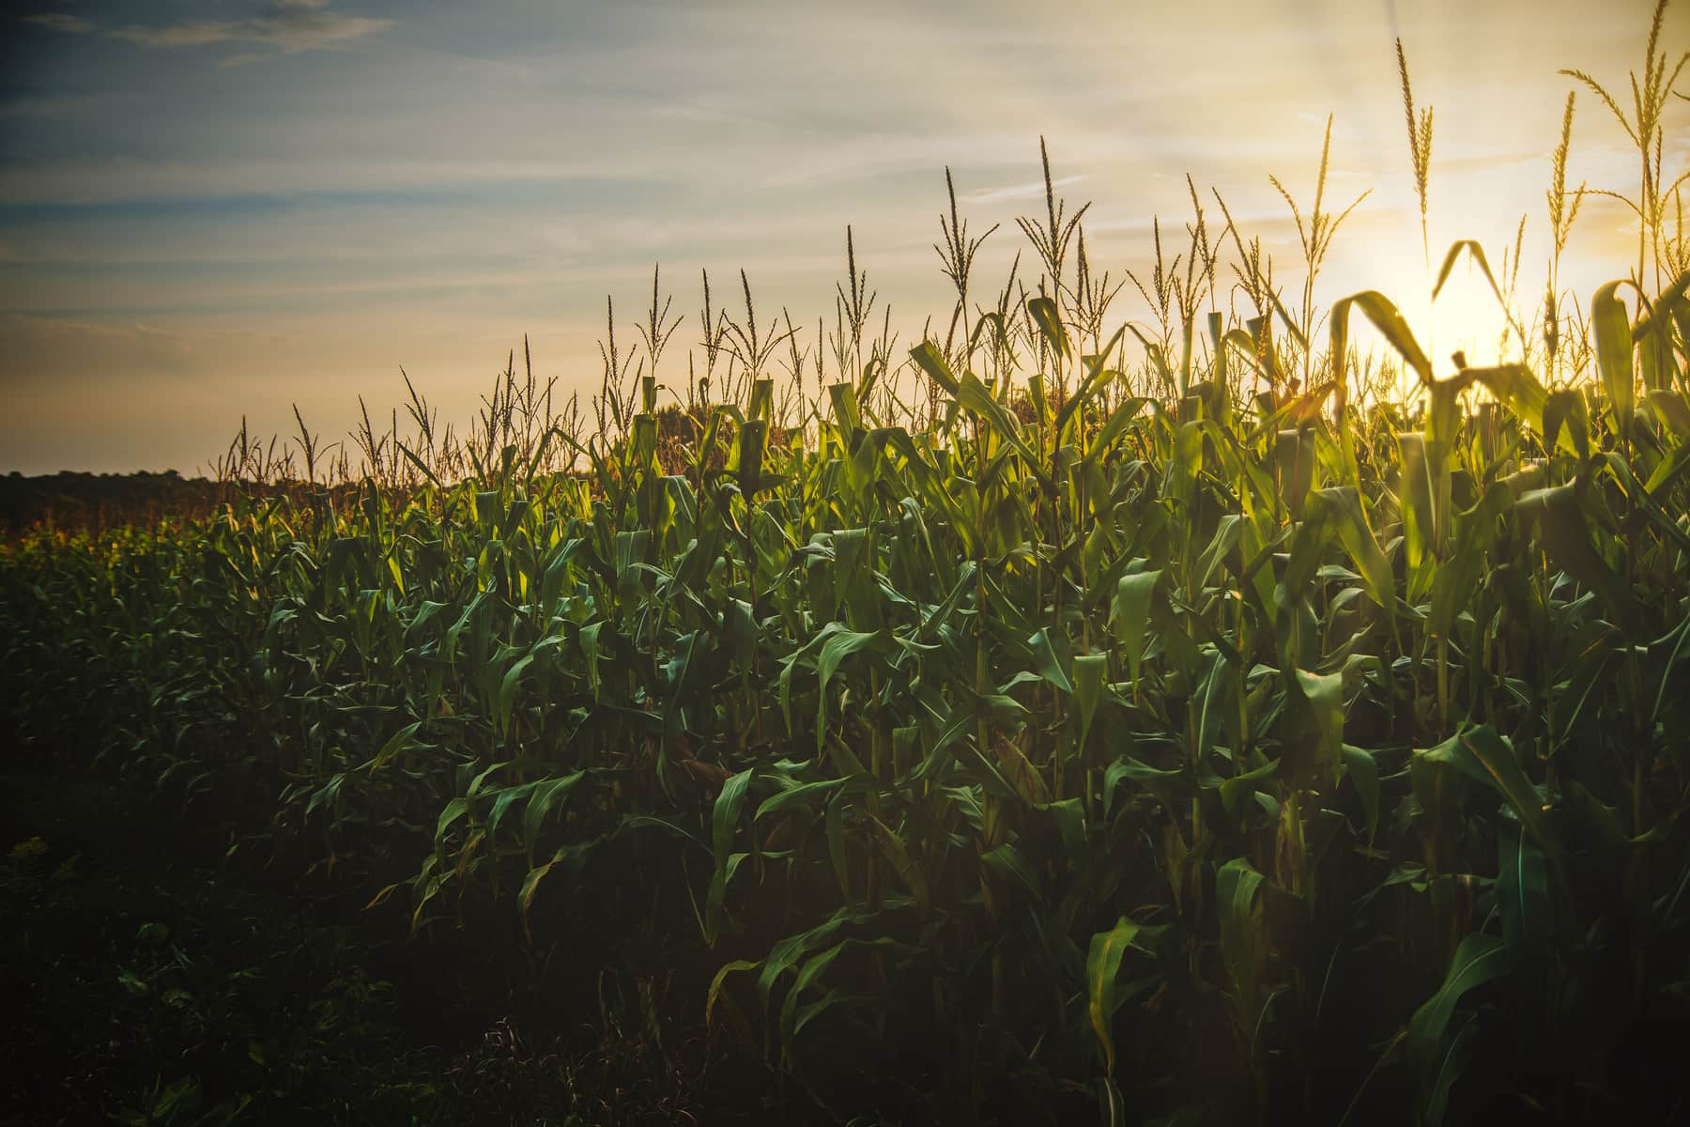
🌾 Abstract Class :(Crop)
abstract class Crop {
protected String name, season, disease = "None";
protected double todayPrice, yesterdayPrice, rainAffectedLand, compensation;
public Crop(String name, String season, double todayPrice, double yesterdayPrice) {
this.name = name; this.season = season;
this.todayPrice = todayPrice; this.yesterdayPrice = yesterdayPrice;
}
public void setDisease(String d) { disease = d; }
public void setRainAffectedLand(double land) {
rainAffectedLand = land; compensation = land * 5000;
}
public abstract String getSuggestion(); // 🔑 To be defined by each crop
}

Slide 6

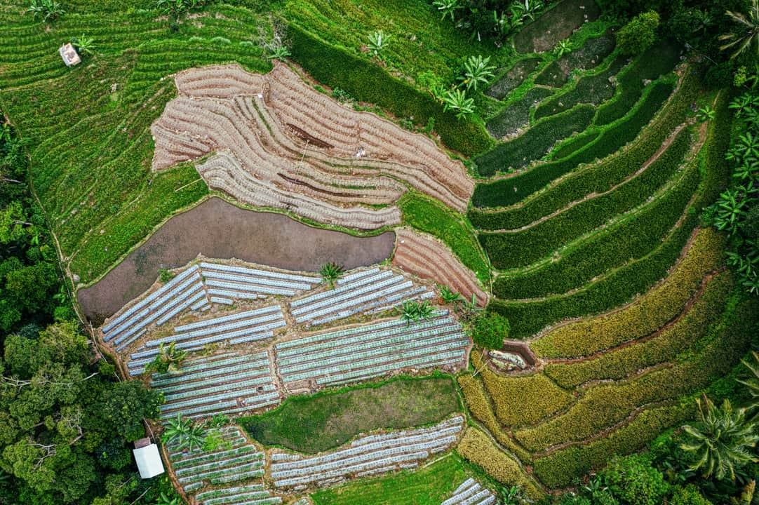
🌱 Subclasses :
class Rice extends Crop {
public Rice(String season, double today, double yesterday) {
super("Rice", season, today, yesterday); // ✅ calls parent constructor
}
@Override
public String getSuggestion() { // ✅ override
return "Irrigate regularly & prevent blast disease.";
}
}
class Wheat extends Crop {
public Wheat(String season, double today, double yesterday) {
super("Wheat", season, today, yesterday);
}
@Override
public String getSuggestion() {
return "Protect against rust by spraying fungicide.";
}
}
👉 Inheritance → Rice and Wheat extend Crop.
👉 Constructor → Subclasses call super(...) to initialize parent.
👉 Override → Each subclass provides its own getSuggestion().

Slide 7
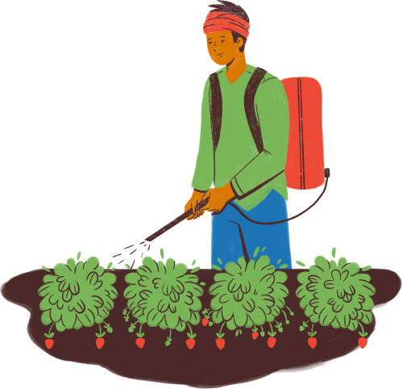
🌾 HarvestHorizon Polymorphism
<<abstract>>
CropComponent
-----------------
- crop : Crop
-----------------
+ generateReport(diseaseInfo: Map) : void
^
----------------|---------------------
| | |
PriceComponent DiseaseComponent RainfallComponent
+ generateReport() + generateReport() + generateReport()
Crop
------------------------------------
- name : String
- season : String
- todayPrice : double
- yesterdayPrice : double
- disease : String
- rainAffectedLand : double
- compensation : double
------------------------------------
+ setDisease(disease : String) : void
+ setRainAffectedLand(land : double) : void
+ getName() : String
+ getSeason() : String
+ getTodayPrice() : double
+ getYesterdayPrice() : double
+ getDisease() : String
+ getRainAffectedLand() : double
+ getCompensation() : double
HarvestHorizonPoly (main)
-----------------------------------------
- diseaseInfo : Map<String, String>
-----------------------------------------
+ main(args : String[]) : void
🔎 Explanation:
CropComponent → Abstract base (like Component in your hardware diagram).
PriceComponent, DiseaseComponent, RainfallComponent → Implement specific logic (polymorphism).
Crop → Holds actual data (state of the crop).
HarvestHorizonPoly → Main driver, creates objects and demonstrates polymorphism.

Slide 8

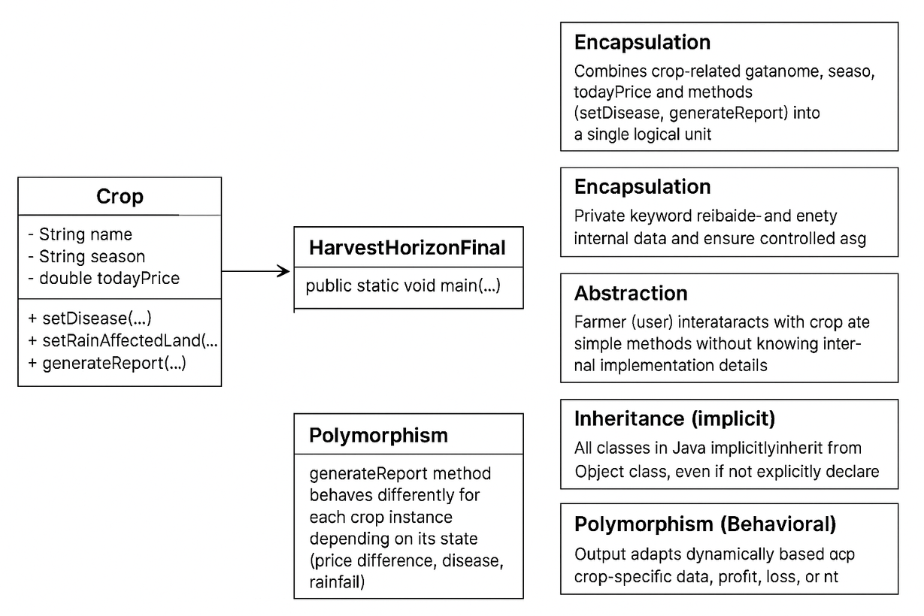

Slide 9

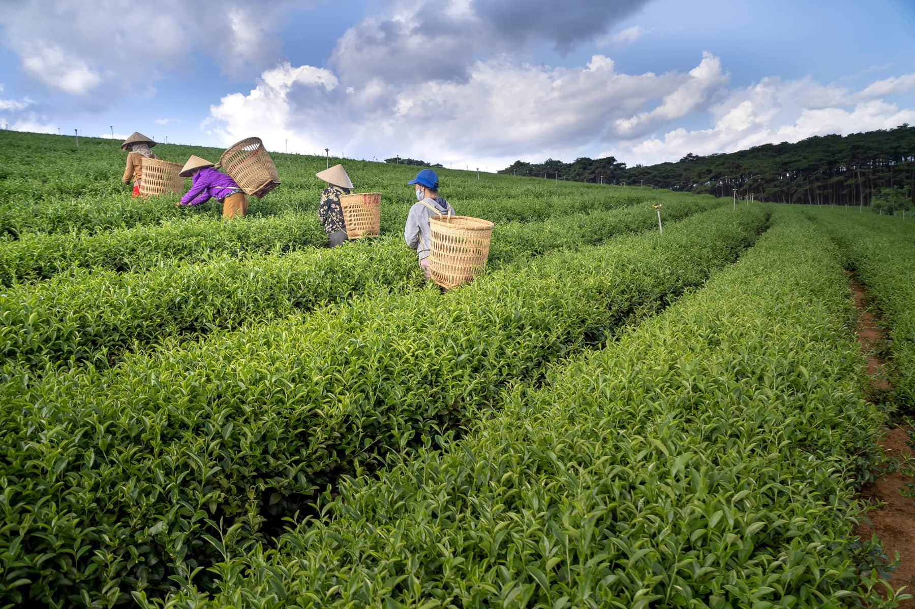
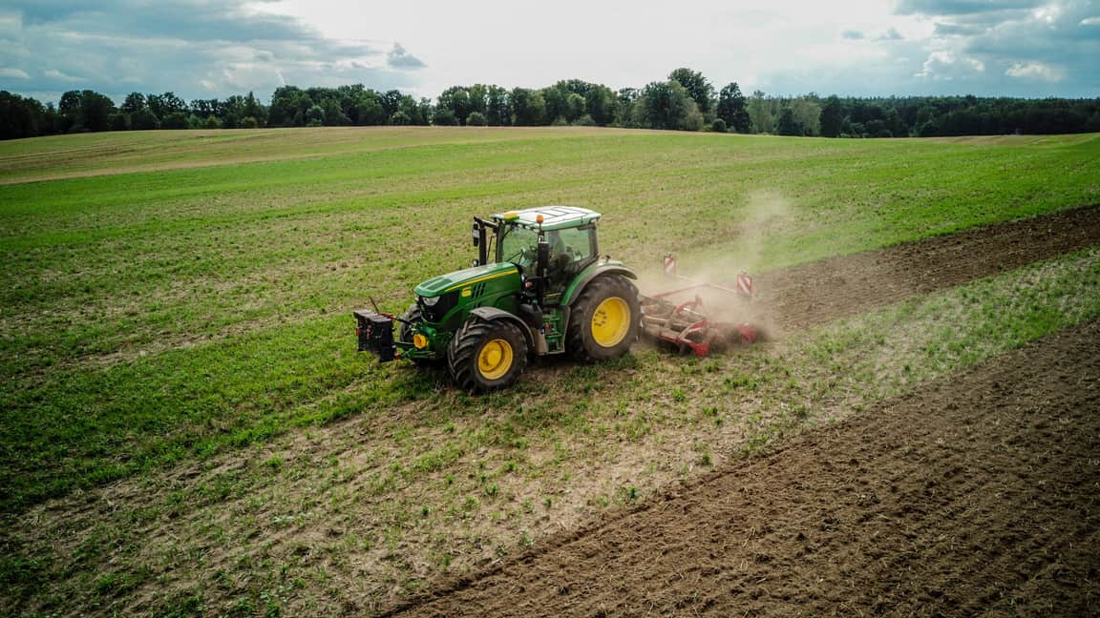
Thank You

